Slide 1


Task-1 Exploratory Data Analysis
Virtual Internship Report
Segment the dataset and draw unique insights, including visualization of the transaction volume and assessing the effect of any outliers.

Slide 2
Load the transaction dataset
Imported the required Libraries:
Pandas as pd
Numpy as np
Matplotlib as plt
Seaborn as sns
I have loaded the ANZ synthesized transaction dataset using python data analysis library Pandas
pd.read_excel(‘ANZ synthesised transaction dataset.xlsx’)

Slide 3
Data Processing
The ANZ synthesised transaction dataset contains total of 12043 rows and 23 different columns of 100 unique customers purchasing data from different locations around Australia for 91 days of unique data i,.e is there 12043 rows are unique.
Also every row contains minimum of one missing column data.
There are many missing values so we have to clean the data and remove the outliers for the required columns

Slide 4
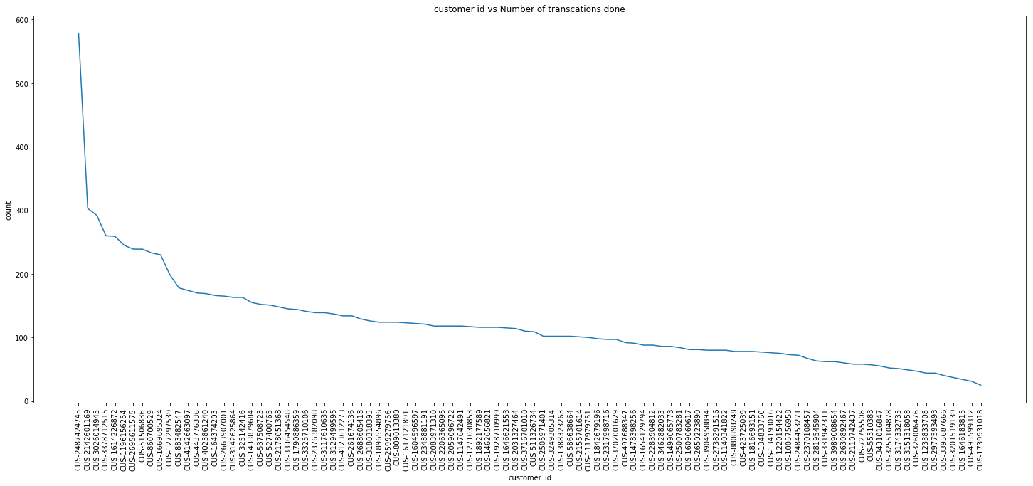
Customer id vs number of transactions
By observing this Line Plot we can see the number of transaction are made by the customers the highest transactions made by one customer is nearly 600

Slide 5
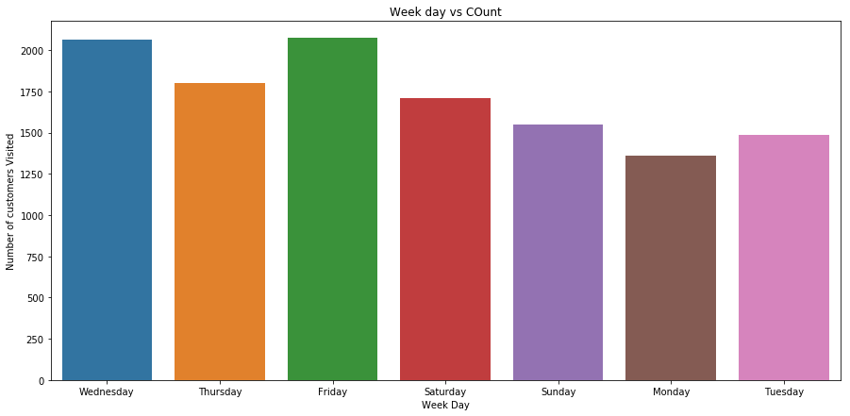
Week day vs Customers Count
By observing the graph we can say that more number of customers are coming on Friday and next Wednesday

Slide 6
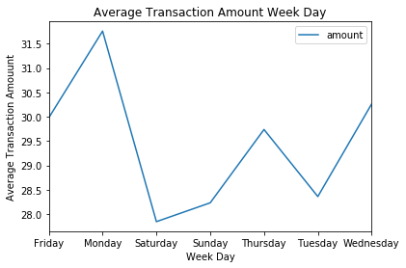
Average Transaction Amount Week Day
From Average Transaction Amount Week Day we can say the people are spending more amount on Monday and less amount on Saturday

Slide 7
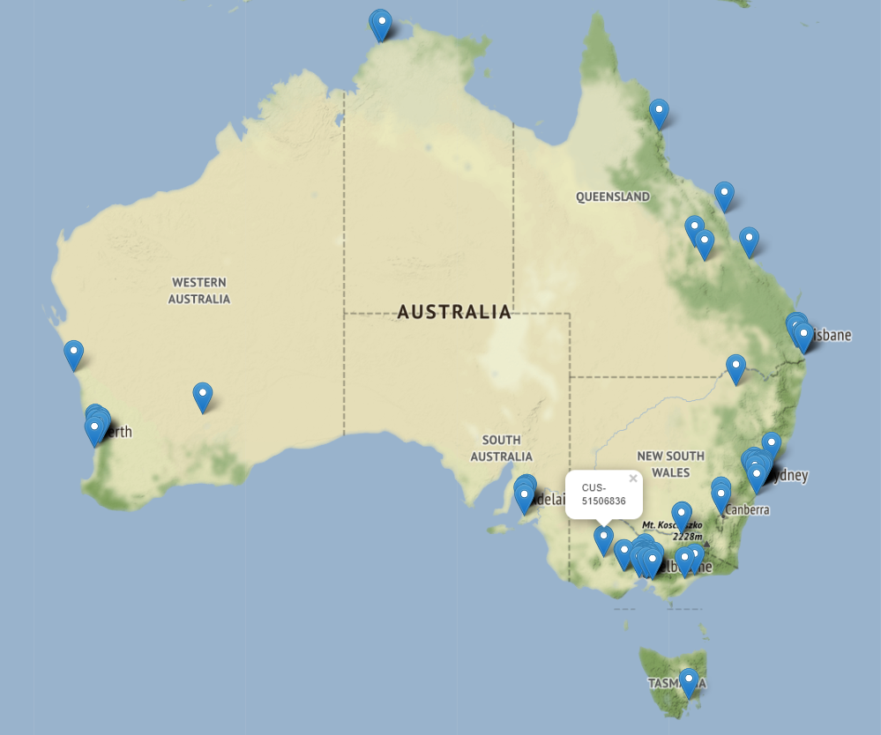
Customers Locations
From Customers locations we can say the they are more customers from New South Wales and few from Queensland and so on.

Slide 8
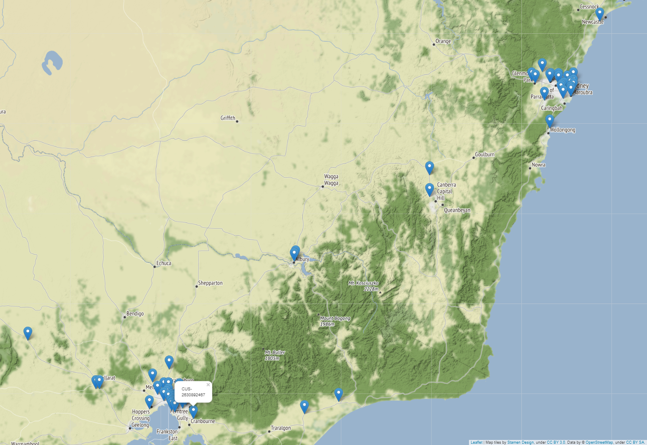
Customers Location

